Slide 1
Battle of neighborhoods
Opening a New restaurant in Mumbai City, India
By Vipin Uniyal

Slide 2
Introduction
The location of your food service business will impact its success nearly as much as the menu. If your restaurant is in the wrong place, you won't attract the number of customers you will need in order to stay in business. The same is true if your location is inundated with competitors, or has poor visibility, or is hard to find. There are many things that must be considered as you look for a location in which to open your business

Slide 3
Problem Statement
The Aim of this capstone project is to analyse and select the best locations in the Mumbai city, India to open a new restaurant. Using data science methodology and machine learning techniques like clustering, this project aims to provide solutions to answer the business question: In the Mumbai city of Maharashtra, India, if any individual person or group are looking to start their restaurant business and want to open a new restaurant, where would you recommend them to open it?

Slide 4
Data Description
Mumbai City District is a district of Maharashtra in Konkan Division. As a city district, it has no headquarters or subdivisions. It, along with the Mumbai Suburban District, makes up the metropolis of Mumbai. The city area is called the "island city" or South Mumbai or Old Mumbai. It extends from Colaba in the south to Mahim and Sion in the north. The city has an area of 157 km² and a population of 3,085,411.
Data Sources:
Data of postal code and areas of Mumbai districts is taken from: https://www.mapsofindia.com/pincode/india/maharashtra/mumbai/
Latitude and longitude data of all the areas is fetched using google’s api and python geocoder library.
The Restaurant data of each neighbourhood is taken using foursquare api.
To generate map python’s geopy and folium library is being used

Slide 5
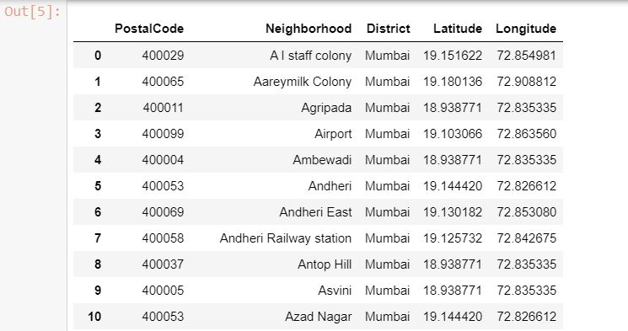
Methodology
I used python beautiful soup4 to crawl the neighbourhood in Mumbai data with postal codes from the website, and converted it into pandas dataframe and then used geocoder to fetch the geographical coordinates. It looks like this:

Slide 6
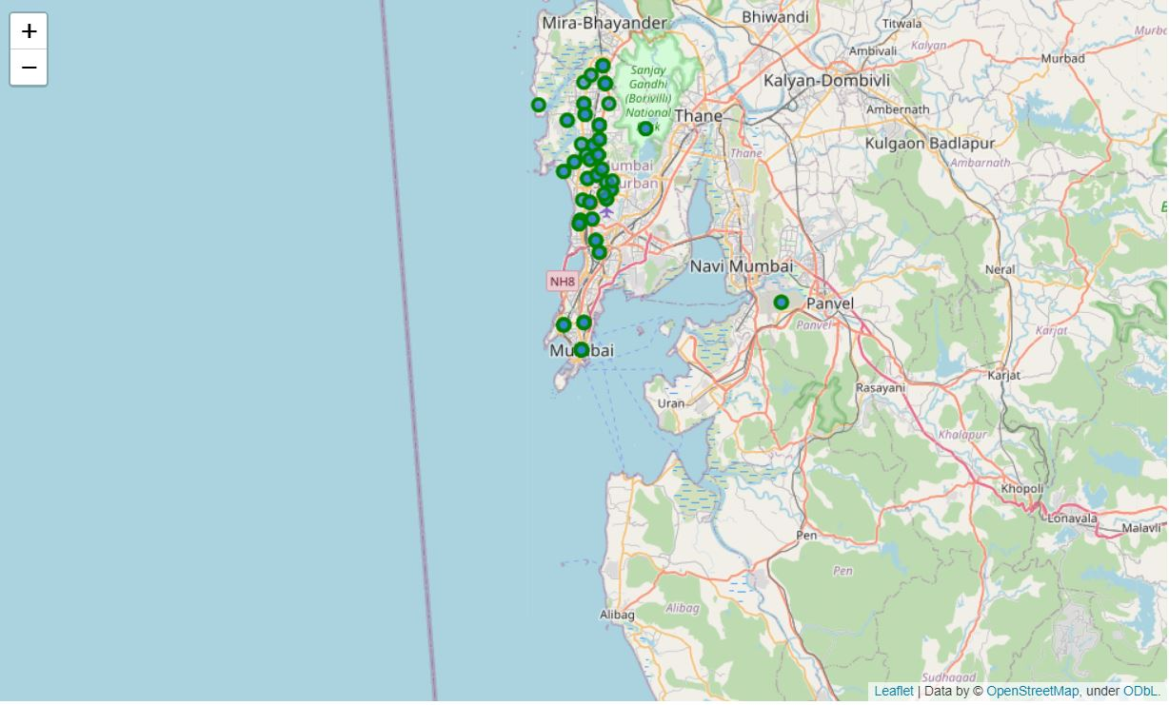
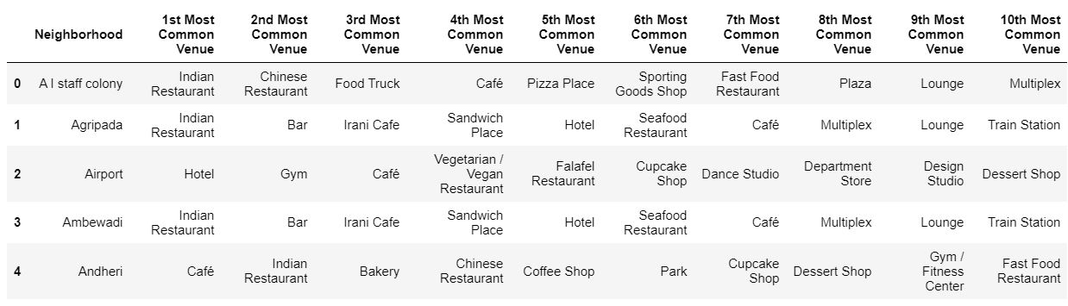
After getting the data I created Mumbai city map using folium library
Then I used foursquare API to fetch the nearby venues in each neighborhood and selected top 10 venues. After that I created a new data set which looks like below:

Slide 7
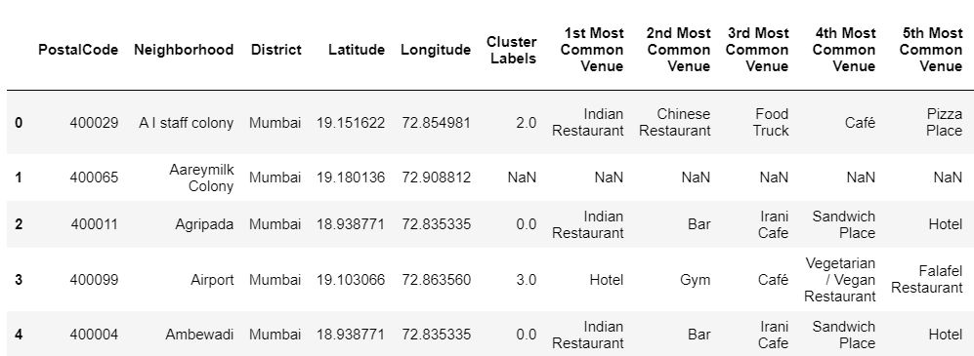
After creating venues dataframe I analysed the data and clustered it using kmeans clustering algorithm and assigned label to each cluster.

Slide 8
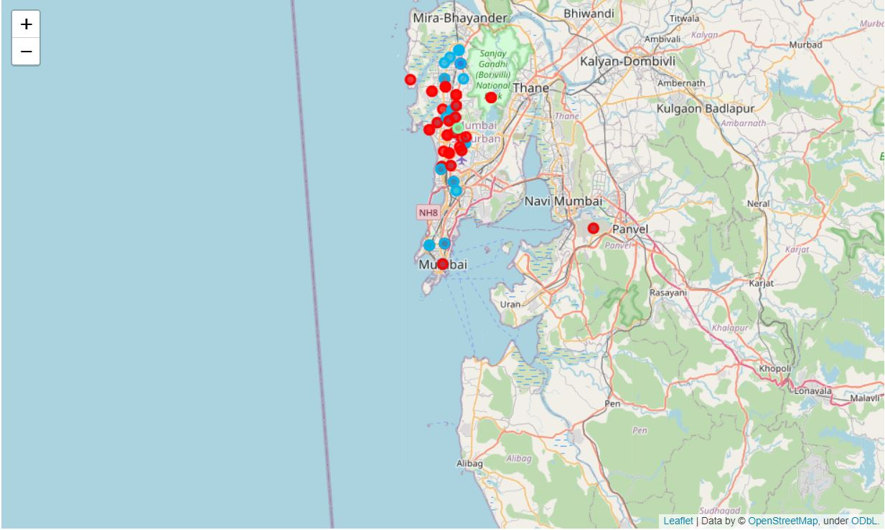
Finally, I visualized the clusters in Mumbai city map.

Slide 9
Result
The cluster with most neighbourhood is cluster 0. It consists following categories in decreasing order of popularity:
Indian Restaurant
Bar
Irani Café
Sandwich Place
Hotel
Seafood Restaurant
Café
Multiplex

Slide 10
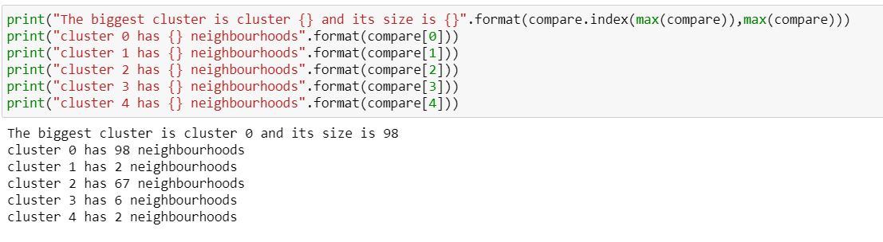
The clusters having following details:
So, the appropriate location to start the restaurant business should be all the neighborhoods falling in cluster 0.

Slide 11
Conclusion
The end of this project brings forth the following conclusions:
The best locations for opening restaurants in Mumbai city are falling under cluster 1 which can be seen in jupyter notebook.
Indian restaurants are most popular in Mumbai city followed by bar and then sea food.
The clusters in map are visualized.
Foursquare API is used and it made easy to fetch the venues in all neighbourhoods

